Slide 1
Applied Data Science Capstone Project
The Battle Of the neighborhoods

Slide 2
Business Problem
Where can we put the Bakery “Get Baked” where there are no other Bakeries around?
Meet the criteria given to you by the client or Bakery could fail.
Client is relying on a Data Scientist to help him solve this problem.

Slide 3
Data
Toronto Postal Code Data: https://en.wikipedia.org/wiki/List_of_postal_codes_of_Canada:_M
Toronto Geographical Coordinates Data: https://cocl.us/Geospatial_data
Foursquare
Other Libraries such as Pandas, Geopy, BeautifulSoup, and Folium to create charts, grab data from websites, and manipulate/clean data into proper dataframes so we can use Kmeans Clustering to get our final results.

Slide 4
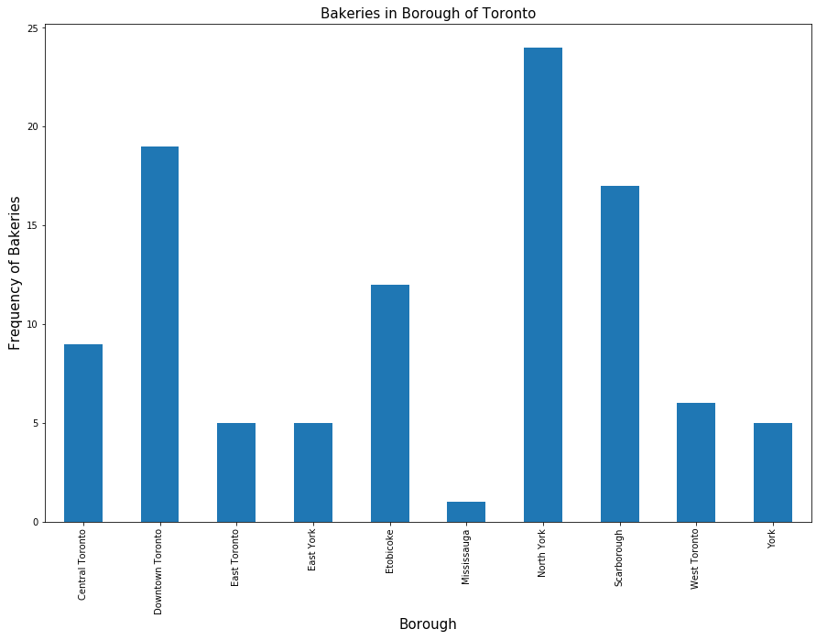
Methodology
Pull Raw Data Into Data Frame Using Pandas
Clean Data And Filter Into Results
Utilize Folium And Other Repositories To Create Graphs And Maps To Make Sense Of Results

Slide 5
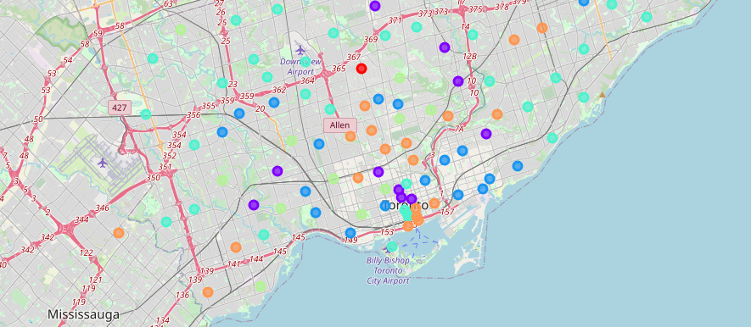
Results
Comparing the results and different clusters, it appears that one of the 6 different clusters stands out among the rest as far as Bakery Frequency. The other clusters vary in size and all seem to have at least one Bakery around.

Slide 6
Discussion
When comparing the clusters, is it really a good thing to place a Bakery where there are none around? Is there a reason for this? Should we maybe change our criteria and find out what is causing there to be no bakeries around? Will we make money here with a new Bakery or will it fail?

Slide 7
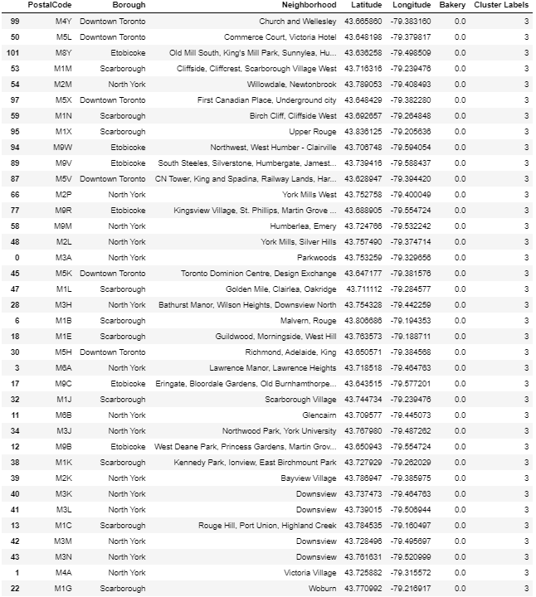
Conclusion
Out of the 6 different clusters, only one of the clusters (Cluster 3) has results where there are no Bakeries at all. Judging by this it appears that anywhere in this cluster it would be the best area to put a Bakery as our client is wanting to place the bakery in an area where no other bakeries are located if possible.

